Slide 1
BLOCKCHAIN AND LEDGERS
Project Title : Patient Centric Image Management
Team Number: 15
Team Members:
1) Shankarling Halemani 01fe20bcs170
2) Tafreen Hussain 01fe20bcs172
3) Shravan Nayak 01fe20bcs174
4) Fayaz 01fe20bcs177
5) Sana Razeen 01fe20bcs184
Guide : Manjula Pawar

Slide 2
PROBLEM STATEMENT :
PCIM(Patient Centric Image Management) :
“Designing a patient-centric distributed architecture for the purpose of medical image storage and sharing, while simultaneously addressing the concerns about privacy, security, access flexibility, and costs”

Slide 3
OBJECTIVES :
To propose a system architecture that facilitates the distributed and secured patient-centric data access across multiple entities.
To use IPFS(Inter Planetary File System) for storage purpose as size of medical images corresponds to the orders of magnitude larger than those a public blockchain can offer.
To write smart contracts that consumes less gas.
To store medical images of patient using IPFS and share and manage medical images using ethereum smart contracts (Blockchain).

Slide 4
LITERATURE SURVEY :
Paper title | Objective | Methodology
Blockchain based distributed patient-centric image management system.[1] | To decrease the maintenance cost with less storage space and to raise privacy concerns while sharing information over a network. | A blockchain based architecture patient image management system (PCIM) is designed. The main components of PCIM are 1)Ethereum blockchain. 2)IPFS storage. 3)Securing medical images. Patient centric access control protocol using smart contract is used to transmit information in and out of the ethereum blockchain.

Slide 5
Paper title | Objective | Methodology
Decentralised patient centric report and medical image management system based on blockchain technology and the Interplanetary file system.[2] | To provide a framework that allows for the efficient exchange and storage of large amount of medical data in a secure setting. | A distributed architecture- Patient centric test report and image management (PCRIM) is implemented to facilitate patient privacy and control. Ethereum and distributed file system technology called the interplanetary file system (IPFS) is used. IPFS allows decentralised storage of medical metadata such as images with worldwide accessibility.

Slide 6
Paper title | Objective | Methodology
Blockchain based medical health record access control scheme with efficient protection mechanism and patient control.[3] | To protect the privacy of patient’s medical health record(PMHR). | The PMHR data is encrypted and stored in a cloud server,which is equipped with an access control scheme. An improved proxy re-encryption scheme is introduced to avoid man-in-the-middle attack while reducing the computational complexity. The implemented smart contract has - 1)Registration contract 2)Access contract 3)Incentive contract 4)Revoke contract

Slide 7
Paper title | Objective | Methodology
Blockchain based access control model to preserve privacy for personal health record systems.[4] | To ensure the privacy and protection of patient health records. | The real PHR data is encrypted using the public key of the PHR owner and stored on a cloud storage. The re encryption keys and other information will be stored on a proxy called the gateway server. The metadata of the PHR will be stored on the private blockchain. This PHR can be accessed by the owner and healthcare providers.

Slide 8
Paper title | Objective | Methodology
Blockchain-enabled decentralized attribute-based access control with policy hiding for smart healthcare.[5] | To avoid single point failure and to protect user information. To solve the problem of mistrust between mobile edge computing (MEC) and the users. | A blockchain enabled payable multi-authority Attribute based encryption (ABE) scheme is constructed with outsourcing decryption. The system model contains seven entities- 1)Global authority. 2)attribute authority. 3)cloud service provider. 4)data owner. 5)data user. 6)mobile edge computing server. 7)blockchain.

Slide 9
FUNCTIONALITIES :
Patient can store his/her personal medical data in blockchain using IPFS
Patient can share his/her medical data with anyone using his/her private key and signing a smart contract.
Patient can view his/her medical data in IPFS using his/her private key.
Patient can create transaction for his/her medical data in blockchain which will be verified by radiologist.

Slide 10
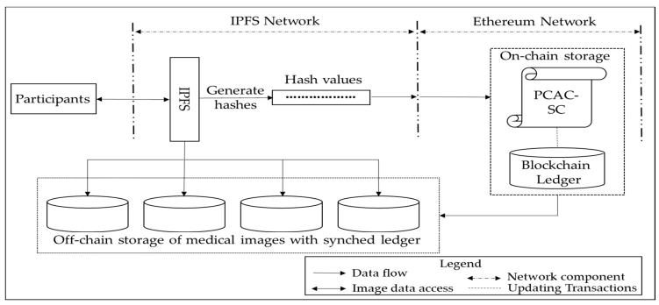
PROPOSED METHODOLOGY:

Slide 11
MODULE DESCRIPTION :
1.Participants
There are two types of participants in our system
1)User who requests for the access.
2)User who provides access -patient.
2.IPFS
IPFS stands for interplanetary file system.
Images are uploaded in the IPFS for which it gives hash code.
3.Off-chain storage
The hashes are then stored in off chain database.
3.On-chain storage
The on-chain storage consists of smart contract.
The hash value generated will be given to the smart-contract.

Slide 12
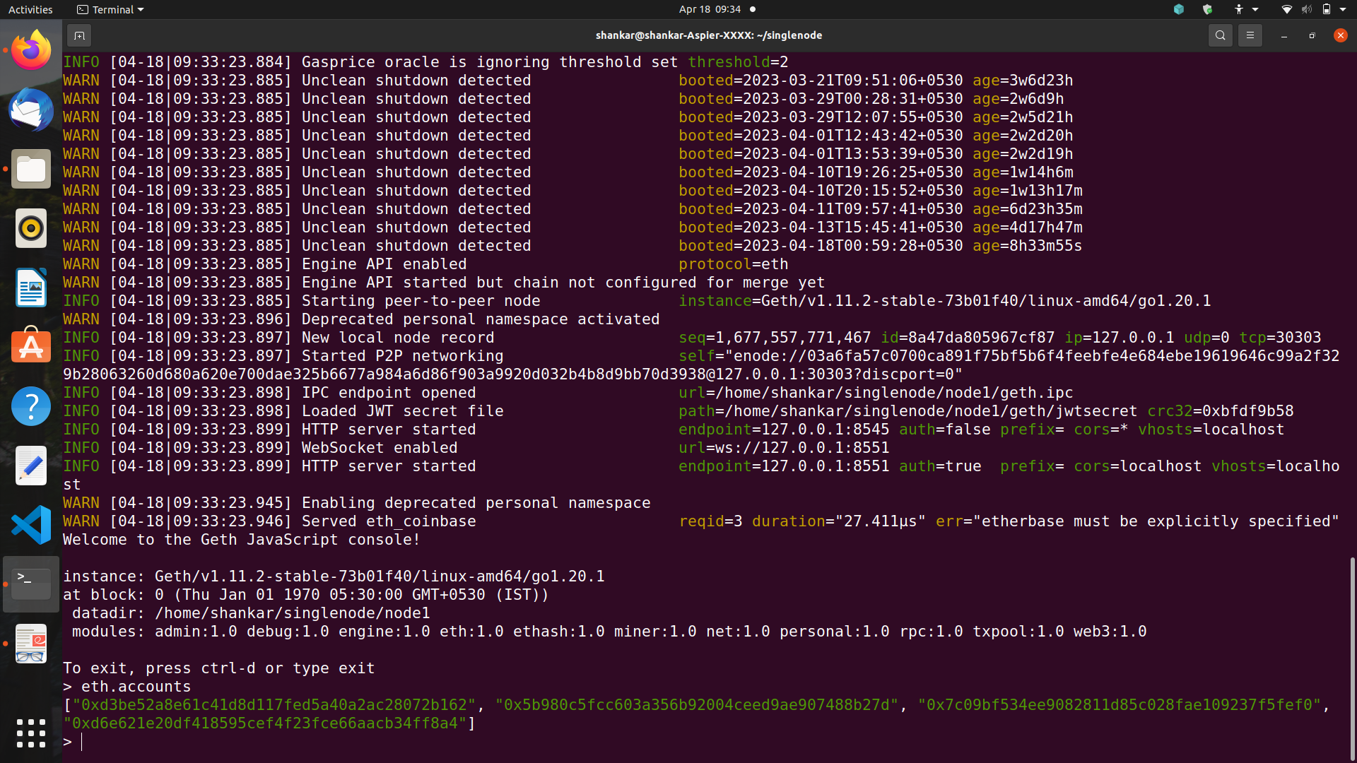
SYSTEM MODULES:
Connected To Geth and ether accounts

Slide 13
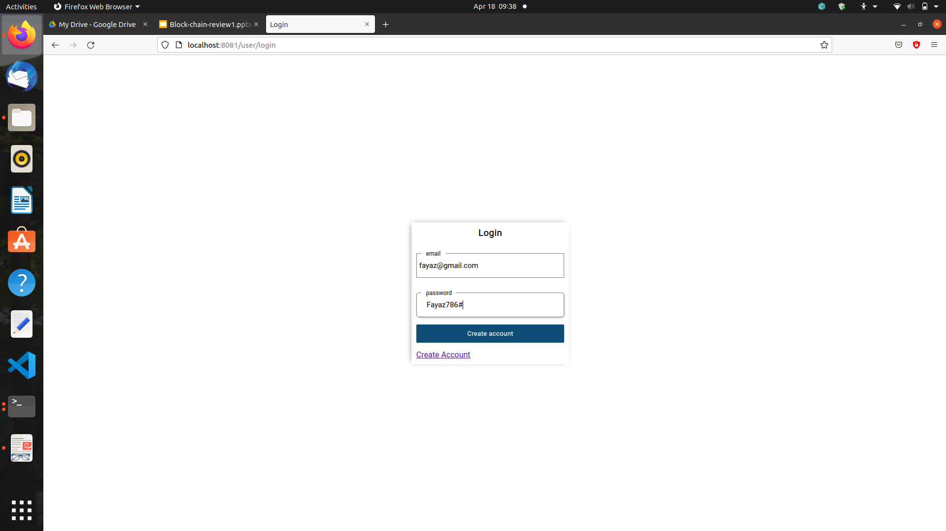
2) Website login Page

Slide 14
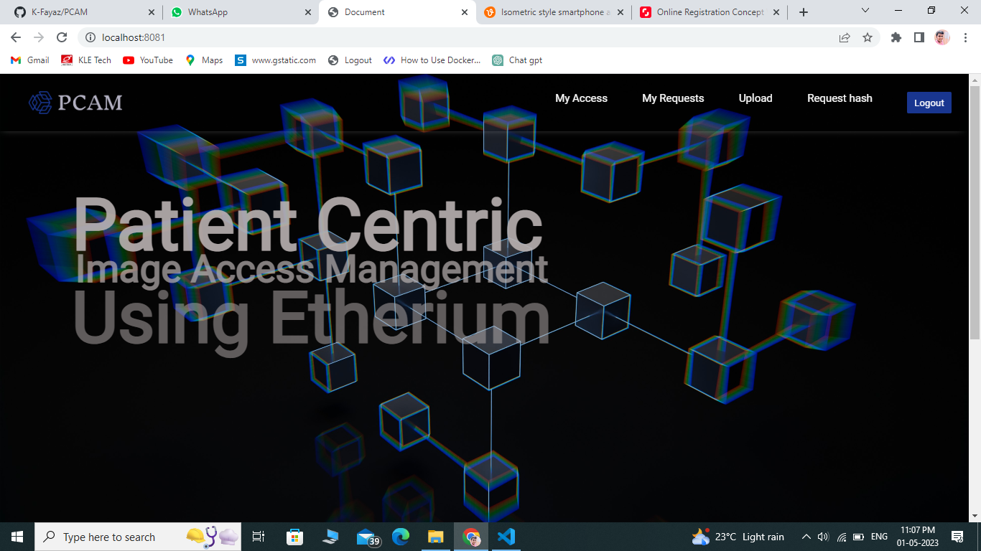
3) Homepage

Slide 15
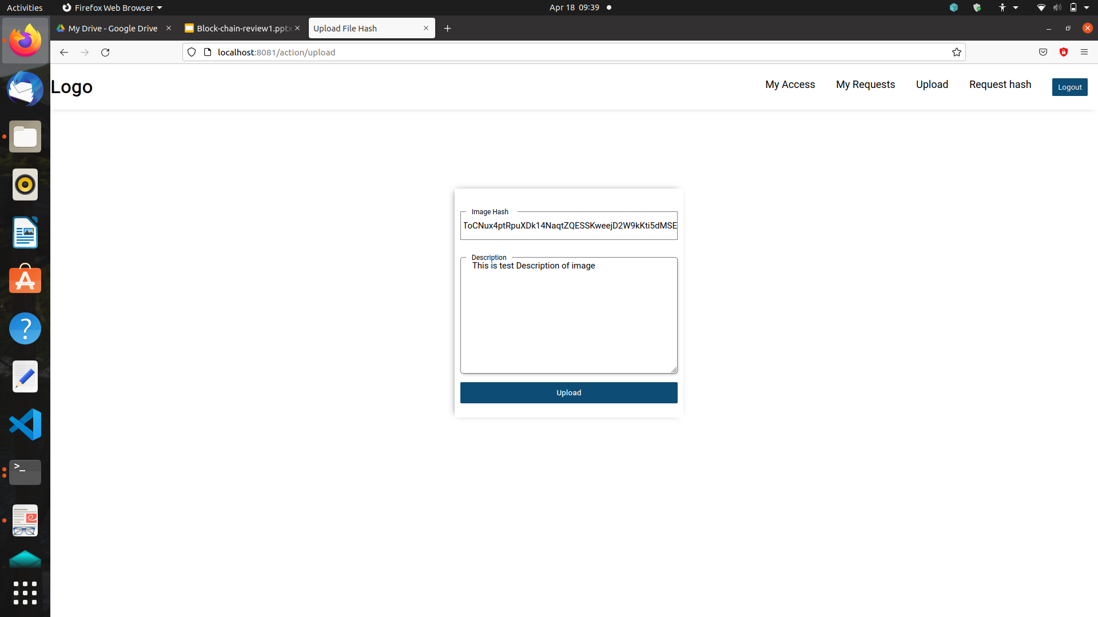
4) Patients uploading images to blockchain network

Slide 16
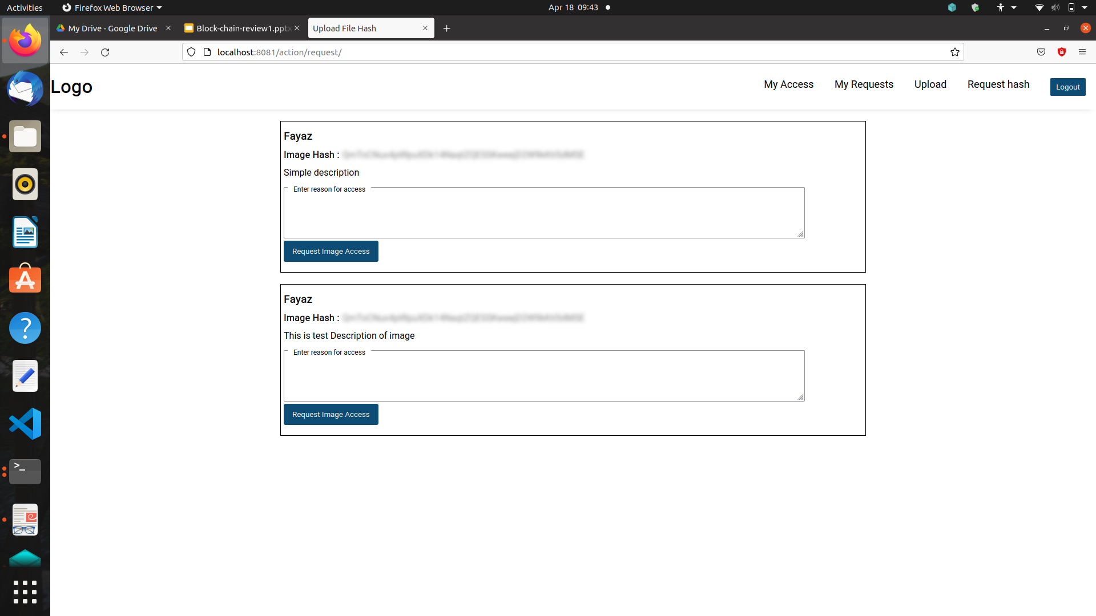
5) User requesting for patient images

Slide 17
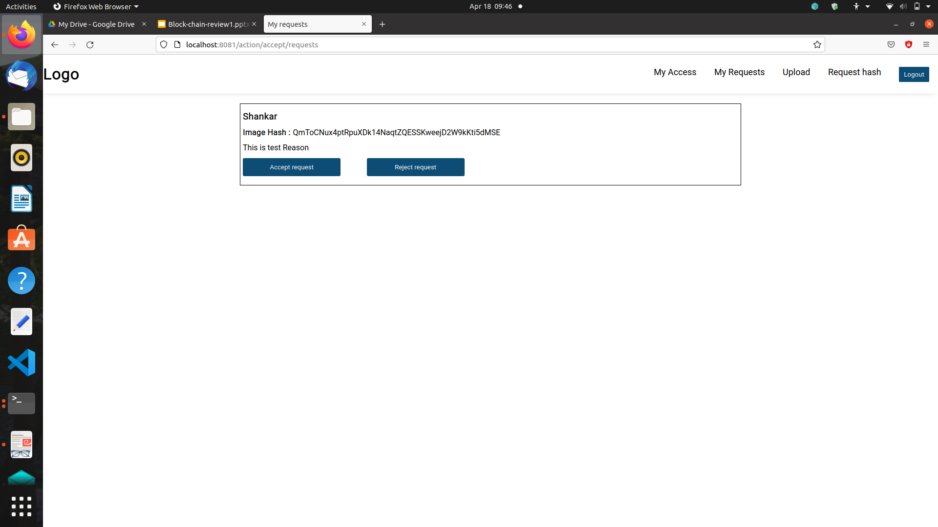
6) Patient can give access or reject access

Slide 18
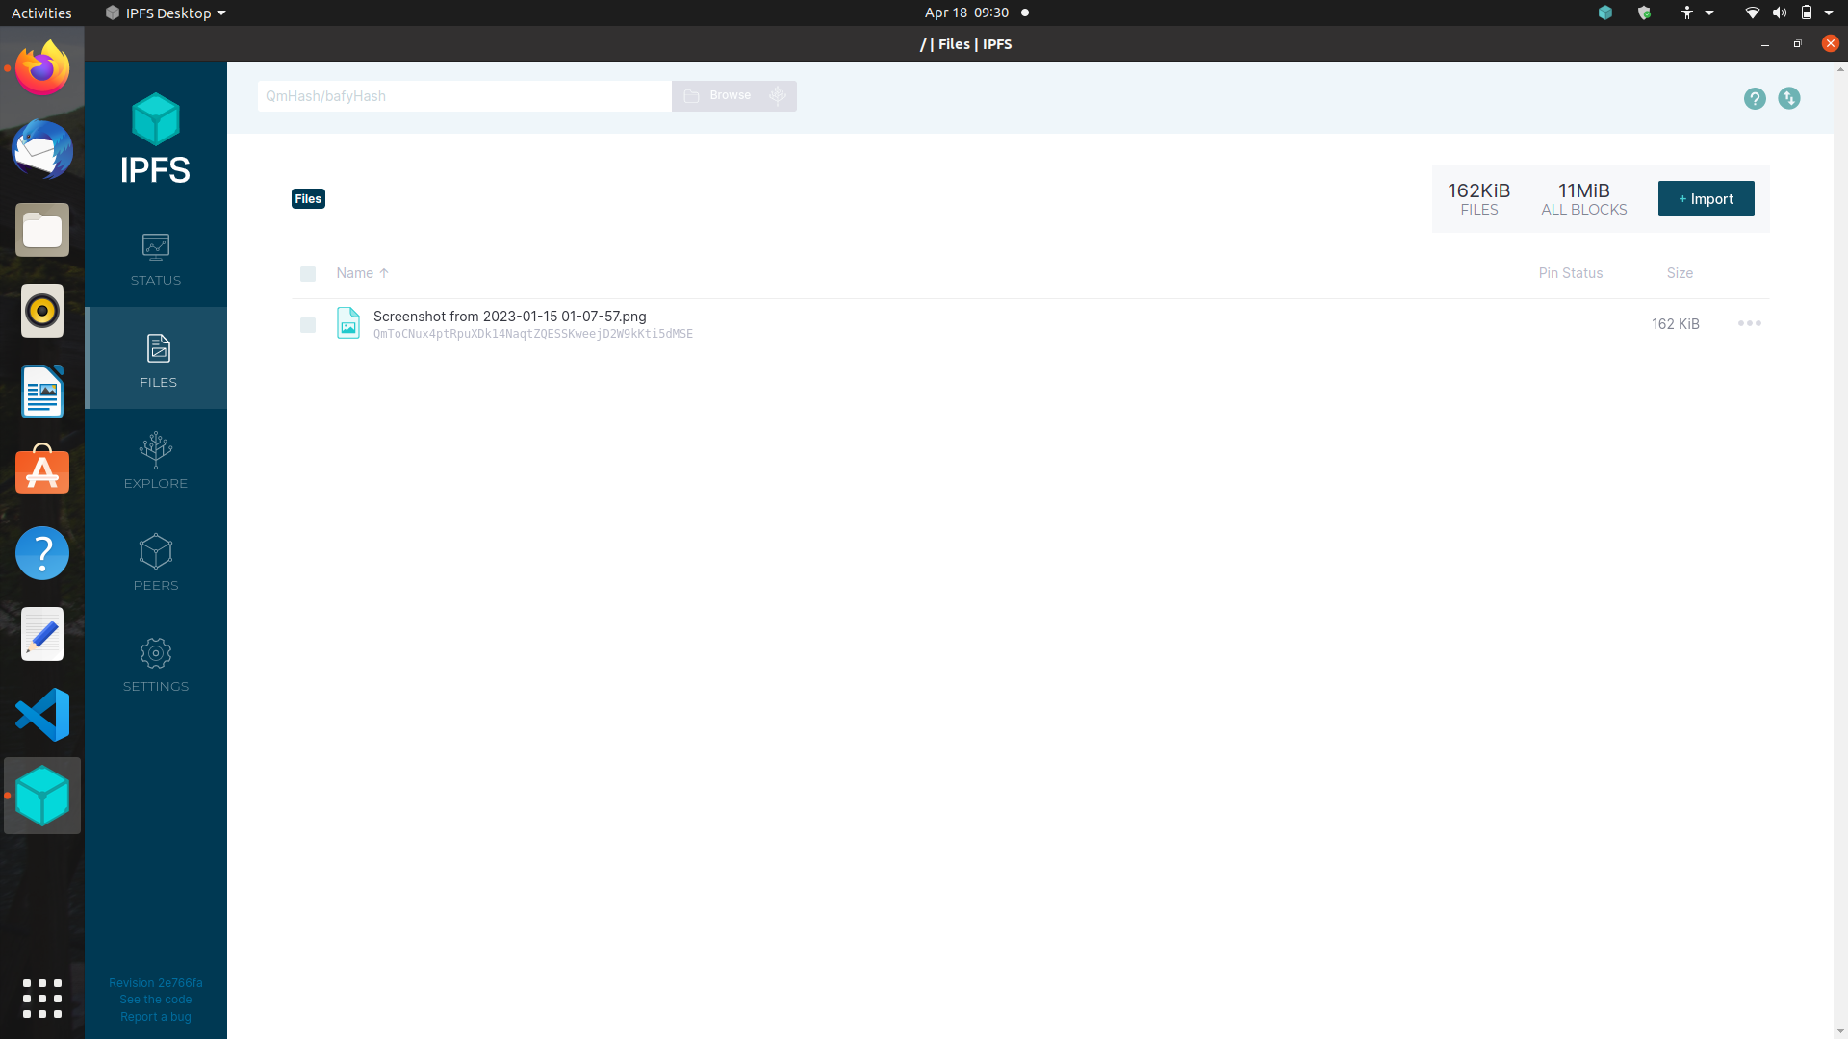
7) Patient uploads images to IPFS to get hash of the image

Slide 19
REFERENCES :
[1] Blockchain based distributed patient-centric image management system.
[2] Decentralised patient centric report and medical image management system based on blockchain technology and the Interplanetary file system.
[3] Blockchain based medical health record access control scheme with efficient protection mechanism and patient control.
[4] Blockchain based access control model to preserve privacy for personal health record systems.
[5] Blockchain-enabled decentralized attribute-based access control with policy hiding for smart healthcare.

Slide 20
THANK YOU…

